Slide 1
Statistics in Machine Learning
The Foundation Behind Intelligent Algorithms
William James A
25PAI818
William James A

Slide 2
What are all the Machine Learning Algorithms Do You Know?
Linear Regression
Polynomial Regression
Logistic Regression
Gaussian Naïve Bayes
Decision Trees
K – means Clustering

Slide 3


Will You Wonder If these Algorithms are made with Statistics?
Machine Learning (ML) is not just about algorithms; it's deeply rooted in statistical theory. Statistics provides the foundational mathematical framework upon which virtually all ML algorithms are built. In fact, an estimated 85% of ML models leverage statistical inference to make their powerful predictions.
This strong foundation is crucial as the global AI market is projected to reach an astonishing $1.8 trillion by 2030, a growth largely fueled by the ability to extract deep insights from vast datasets.

Slide 4
Understanding the Core Connection
Machine Learning
Machine Learning involves algorithms that learn intricate patterns and relationships directly from data, enabling systems to perform tasks without explicit programming. It's about teaching computers to adapt and improve over time.

Slide 5

Understanding the Core Connection
Machine Learning
Machine Learning involves algorithms that learn intricate patterns and relationships directly from data, enabling systems to perform tasks without explicit programming. It's about teaching computers to adapt and improve over time.

Slide 6
Understanding the Core Connection
Machine Learning
Statistics
Machine Learning involves algorithms that learn intricate patterns and relationships directly from data, enabling systems to perform tasks without explicit programming. It's about teaching computers to adapt and improve over time.
Statistics, on the other hand, is the scientific discipline dedicated to the rigorous collection, meticulous analysis, insightful interpretation, and effective presentation of data. It provides the tools to understand the underlying structure of information.

Slide 7
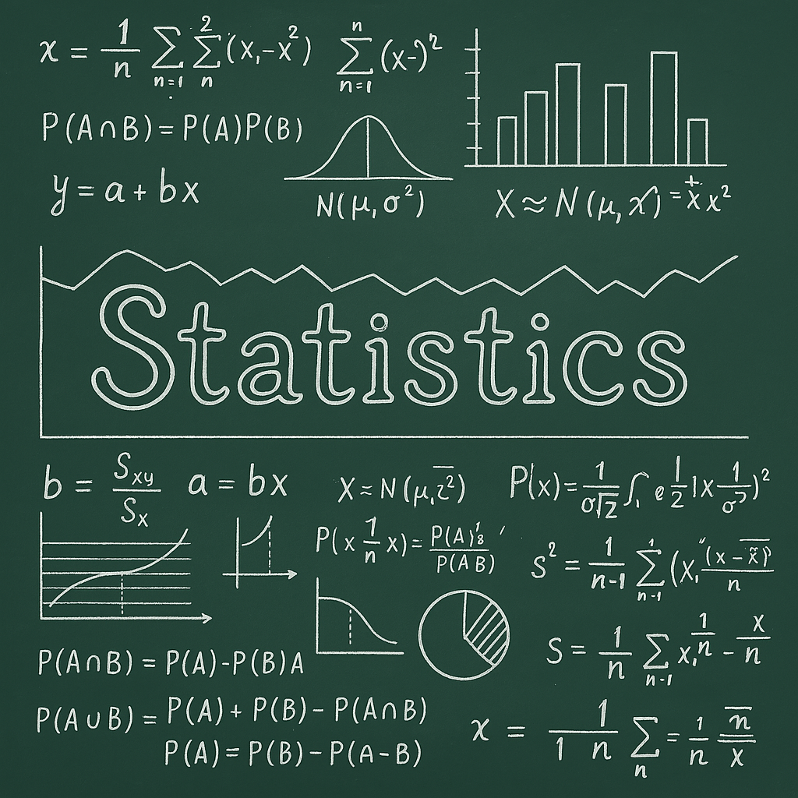
Understanding the Core Connection
Machine Learning
Statistics
Machine Learning involves algorithms that learn intricate patterns and relationships directly from data, enabling systems to perform tasks without explicit programming. It's about teaching computers to adapt and improve over time.
Statistics, on the other hand, is the scientific discipline dedicated to the rigorous collection, meticulous analysis, insightful interpretation, and effective presentation of data. It provides the tools to understand the underlying structure of information.

Slide 8
Understanding the Core Connection
Machine Learning
Statistics
Machine Learning involves algorithms that learn intricate patterns and relationships directly from data, enabling systems to perform tasks without explicit programming. It's about teaching computers to adapt and improve over time.
Statistics, on the other hand, is the scientific discipline dedicated to the rigorous collection, meticulous analysis, insightful interpretation, and effective presentation of data. It provides the tools to understand the underlying structure of information.
At its heart, Machine Learning can be viewed as applied statistics, automating and scaling complex data analysis. The predictive accuracy of ML models is often directly proportional to the statistical rigor employed in their design and implementation.

Slide 9
Descriptive Statistics: Summarizing the Data
Descriptive statistics are the first line of defense in understanding any dataset. They provide a concise summary, crucial for initial data exploration and preprocessing before any complex modeling begins.

Slide 10


Descriptive Statistics: Summarizing the Data
Descriptive statistics are the first line of defense in understanding any dataset. They provide a concise summary, crucial for initial data exploration and preprocessing before any complex modeling begins.
Central Tendency
Measures like Mean, Median, and Mode help identify the typical value in your data. For instance, knowing the average house price helps understand a key feature for regression models.

Slide 11

Descriptive Statistics: Summarizing the Data
Descriptive statistics are the first line of defense in understanding any dataset. They provide a concise summary, crucial for initial data exploration and preprocessing before any complex modeling begins.
Central Tendency
Variability
Measures like Mean, Median, and Mode help identify the typical value in your data. For instance, knowing the average house price helps understand a key feature for regression models.
Standard Deviation, Variance, and Range quantify the spread or dispersion of data points. Understanding the spread of customer ages, for example, reveals demographic diversity.

Slide 12
Descriptive Statistics: Summarizing the Data
Descriptive statistics are the first line of defense in understanding any dataset. They provide a concise summary, crucial for initial data exploration and preprocessing before any complex modeling begins.
Central Tendency
Variability
Measures like Mean, Median, and Mode help identify the typical value in your data. For instance, knowing the average house price helps understand a key feature for regression models.
Standard Deviation, Variance, and Range quantify the spread or dispersion of data points. Understanding the spread of customer ages, for example, reveals demographic diversity.
Distribution
Skewness and Kurtosis describe the shape of the data distribution, helping to identify imbalances or unusual patterns, such as imbalanced classes in a classification task.

Slide 13

Descriptive Statistics: Summarizing the Data
Descriptive statistics are the first line of defense in understanding any dataset. They provide a concise summary, crucial for initial data exploration and preprocessing before any complex modeling begins.
Central Tendency
Variability
Measures like Mean, Median, and Mode help identify the typical value in your data. For instance, knowing the average house price helps understand a key feature for regression models.
Standard Deviation, Variance, and Range quantify the spread or dispersion of data points. Understanding the spread of customer ages, for example, reveals demographic diversity.
Distribution
Correlation
Skewness and Kurtosis describe the shape of the data distribution, helping to identify imbalances or unusual patterns, such as imbalanced classes in a classification task.
Pearson's R measures the strength and direction of a linear relationship between two variables. It's vital for feature selection, identifying highly correlated features (e.g., R-value > 0.8) to prevent redundancy.

Slide 14
Inferential Statistics: Drawing Conclusions and Predictions
While descriptive statistics summarize, inferential statistics enable us to go further: extrapolating insights from a sample dataset to make broader conclusions and predictions about a larger population. This is fundamental for validating model findings and ensuring generalizability.

Slide 15

Inferential Statistics: Drawing Conclusions and Predictions
While descriptive statistics summarize, inferential statistics enable us to go further: extrapolating insights from a sample dataset to make broader conclusions and predictions about a larger population. This is fundamental for validating model findings and ensuring generalizability.
Hypothesis Testing
Crucial for A/B testing, it allows us to compare model performance, for example, determining if a new model's improvement is statistically significant (e.g., p-value < 0.05).

Slide 16

Inferential Statistics: Drawing Conclusions and Predictions
While descriptive statistics summarize, inferential statistics enable us to go further: extrapolating insights from a sample dataset to make broader conclusions and predictions about a larger population. This is fundamental for validating model findings and ensuring generalizability.
Hypothesis Testing
Crucial for A/B testing, it allows us to compare model performance, for example, determining if a new model's improvement is statistically significant (e.g., p-value < 0.05).
Confidence Intervals
These provide a range around a prediction, quantifying the uncertainty. For example, stating with 95% confidence that a customer will spend between $50 and $70.

Slide 17

Inferential Statistics: Drawing Conclusions and Predictions
While descriptive statistics summarize, inferential statistics enable us to go further: extrapolating insights from a sample dataset to make broader conclusions and predictions about a larger population. This is fundamental for validating model findings and ensuring generalizability.
Hypothesis Testing
Crucial for A/B testing, it allows us to compare model performance, for example, determining if a new model's improvement is statistically significant (e.g., p-value < 0.05).
Confidence Intervals
These provide a range around a prediction, quantifying the uncertainty. For example, stating with 95% confidence that a customer will spend between $50 and $70.
Sampling Techniques
Methods like Random and Stratified sampling ensure that the training datasets are representative of the entire population, preventing bias and improving model generalization.

Slide 18
Inferential Statistics: Drawing Conclusions and Predictions
While descriptive statistics summarize, inferential statistics enable us to go further: extrapolating insights from a sample dataset to make broader conclusions and predictions about a larger population. This is fundamental for validating model findings and ensuring generalizability.
Hypothesis Testing
Crucial for A/B testing, it allows us to compare model performance, for example, determining if a new model's improvement is statistically significant (e.g., p-value < 0.05).
Confidence Intervals
These provide a range around a prediction, quantifying the uncertainty. For example, stating with 95% confidence that a customer will spend between $50 and $70.
Sampling Techniques
Methods like Random and Stratified sampling ensure that the training datasets are representative of the entire population, preventing bias and improving model generalization.
Inferential statistics are thus critical for assessing how well a model will perform on unseen data, which is the ultimate goal of machine learning.

Slide 19
Probability Theory: The Language of Uncertainty
Probability theory provides the mathematical framework to deal with uncertainty and chance, a critical component underpinning many machine learning algorithms, especially those involved in classification and complex decision-making processes.

Slide 20

Probability Theory: The Language of Uncertainty
Probability theory provides the mathematical framework to deal with uncertainty and chance, a critical component underpinning many machine learning algorithms, especially those involved in classification and complex decision-making processes.
Conditional Probability
Expressed as P(A|B), this is the probability of event A occurring given that event B has already occurred. It's fundamental to algorithms like Naive Bayes, often used in spam detection to determine the likelihood of a message being spam given certain words.

Slide 21

Probability Theory: The Language of Uncertainty
Probability theory provides the mathematical framework to deal with uncertainty and chance, a critical component underpinning many machine learning algorithms, especially those involved in classification and complex decision-making processes.
Conditional Probability
Bayes' Theorem
Expressed as P(A|B), this is the probability of event A occurring given that event B has already occurred. It's fundamental to algorithms like Naive Bayes, often used in spam detection to determine the likelihood of a message being spam given certain words.
A powerful rule for updating the probability estimate for a hypothesis as more evidence or information becomes available. It forms the very foundation of Bayesian machine learning, allowing models to adapt and learn iteratively.

Slide 22

Probability Theory: The Language of Uncertainty
Probability theory provides the mathematical framework to deal with uncertainty and chance, a critical component underpinning many machine learning algorithms, especially those involved in classification and complex decision-making processes.
Conditional Probability
Bayes' Theorem
Probability Distributions
Expressed as P(A|B), this is the probability of event A occurring given that event B has already occurred. It's fundamental to algorithms like Naive Bayes, often used in spam detection to determine the likelihood of a message being spam given certain words.
A powerful rule for updating the probability estimate for a hypothesis as more evidence or information becomes available. It forms the very foundation of Bayesian machine learning, allowing models to adapt and learn iteratively.
Functions that describe the likelihood of different outcomes. Common distributions like Normal, Bernoulli, and Poisson are used to model various data characteristics, from continuous measurements to discrete events, influencing how algorithms process information.

Slide 23
Probability Theory: The Language of Uncertainty
Probability theory provides the mathematical framework to deal with uncertainty and chance, a critical component underpinning many machine learning algorithms, especially those involved in classification and complex decision-making processes.
Conditional Probability
Bayes' Theorem
Probability Distributions
Expressed as P(A|B), this is the probability of event A occurring given that event B has already occurred. It's fundamental to algorithms like Naive Bayes, often used in spam detection to determine the likelihood of a message being spam given certain words.
A powerful rule for updating the probability estimate for a hypothesis as more evidence or information becomes available. It forms the very foundation of Bayesian machine learning, allowing models to adapt and learn iteratively.
Functions that describe the likelihood of different outcomes. Common distributions like Normal, Bernoulli, and Poisson are used to model various data characteristics, from continuous measurements to discrete events, influencing how algorithms process information.
Mastering probability is key to quantifying likelihoods and making robust probabilistic predictions, such as estimating an 85% chance of customer churn based on their behavior.

Slide 24
Statistical Algorithms in Action: Regression & Classification
Many core machine learning algorithms are direct applications of statistical principles, demonstrating how theoretical statistics translates into practical predictive power.

Slide 25
Statistical Algorithms in Action: Regression & Classification
Many core machine learning algorithms are direct applications of statistical principles, demonstrating how theoretical statistics translates into practical predictive power.
Linear Regression
Utilizes Ordinary Least Squares (OLS) to minimize the sum of squared residuals, making it ideal for predicting continuous values, like forecasting housing prices with a typical R-squared of 90%.

Slide 26
Statistical Algorithms in Action: Regression & Classification
Many core machine learning algorithms are direct applications of statistical principles, demonstrating how theoretical statistics translates into practical predictive power.
Linear Regression
Logistic Regression
Utilizes Ordinary Least Squares (OLS) to minimize the sum of squared residuals, making it ideal for predicting continuous values, like forecasting housing prices with a typical R-squared of 90%.
A Generalized Linear Model (GLM) that employs a sigmoid function to model the probability of a binary outcome. It's highly effective for tasks such as predicting loan default with around 88% accuracy.

Slide 27
Statistical Algorithms in Action: Regression & Classification
Many core machine learning algorithms are direct applications of statistical principles, demonstrating how theoretical statistics translates into practical predictive power.
Linear Regression
Logistic Regression
Utilizes Ordinary Least Squares (OLS) to minimize the sum of squared residuals, making it ideal for predicting continuous values, like forecasting housing prices with a typical R-squared of 90%.
A Generalized Linear Model (GLM) that employs a sigmoid function to model the probability of a binary outcome. It's highly effective for tasks such as predicting loan default with around 88% accuracy.
Naive Bayes
Applies Bayes' Theorem under strong independence assumptions. It's commonly used in text classification, for example, achieving an 82% F1-score in sentiment analysis.

Slide 28
Statistical Algorithms in Action: Regression & Classification
Many core machine learning algorithms are direct applications of statistical principles, demonstrating how theoretical statistics translates into practical predictive power.
Linear Regression
Logistic Regression
Utilizes Ordinary Least Squares (OLS) to minimize the sum of squared residuals, making it ideal for predicting continuous values, like forecasting housing prices with a typical R-squared of 90%.
A Generalized Linear Model (GLM) that employs a sigmoid function to model the probability of a binary outcome. It's highly effective for tasks such as predicting loan default with around 88% accuracy.
Naive Bayes
Support Vector Machines (SVM)
Applies Bayes' Theorem under strong independence assumptions. It's commonly used in text classification, for example, achieving an 82% F1-score in sentiment analysis.
Based on statistical learning theory, SVMs find the optimal hyperplane that maximizes the margin between different classes, providing robust classification capabilities.

Slide 29
Let’s go into a simple Algorithm
Linear Regression

Slide 30
Let’s go into a simple Algorithm
Linear Regression
Linear regression is a statistical method used to model the relationship between a dependent variable and one or more independent variables by fitting a linear equation to the observed data. It aims to find the "line of best fit" that minimizes the difference between predicted and actual values. This technique is widely used in various fields for prediction and understanding relationships between variables

Slide 31
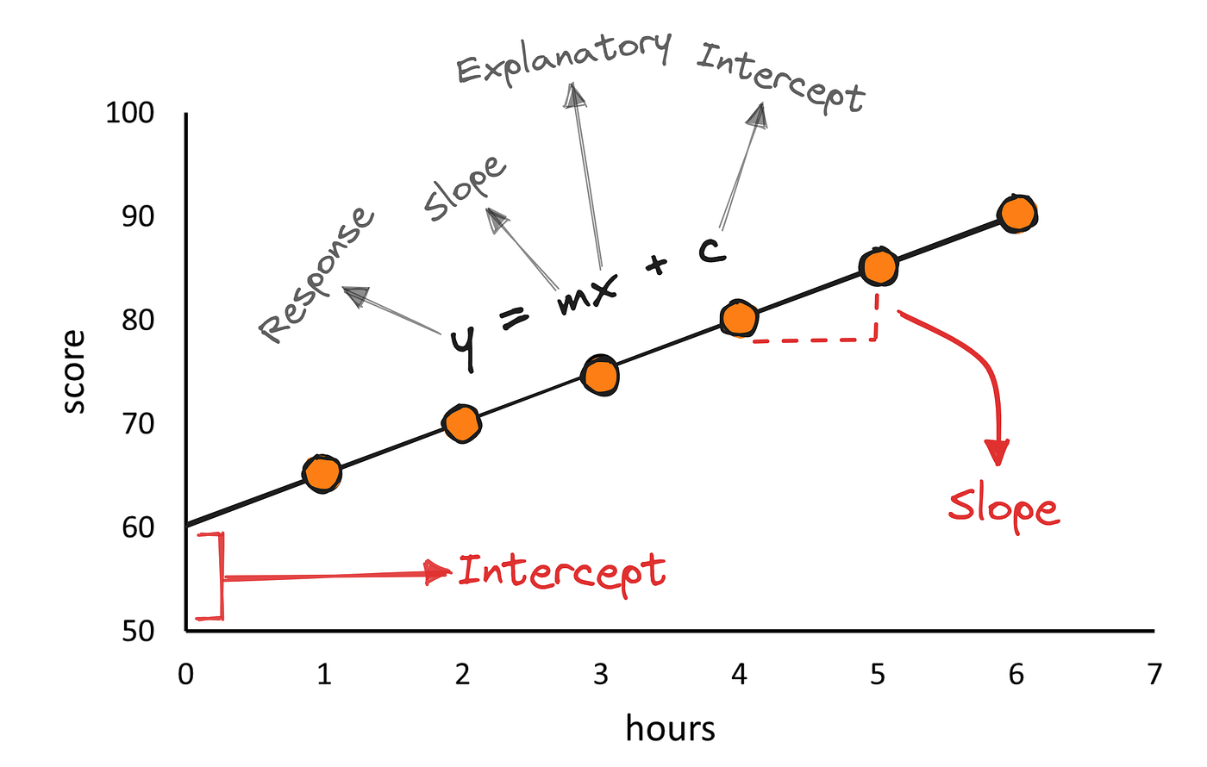
Let’s go into a simple Algorithm
Linear Regression
Linear regression is a statistical method used to model the relationship between a dependent variable and one or more independent variables by fitting a linear equation to the observed data. It aims to find the "line of best fit" that minimizes the difference between predicted and actual values. This technique is widely used in various fields for prediction and understanding relationships between variables

Slide 32
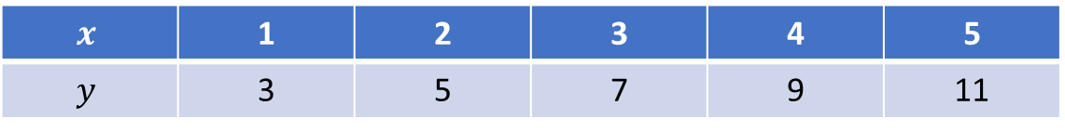
Solve a simple problem using method of least squares
$$x$$ | 1 | 2 | 3 | 4 | 5
$$y$$ | 3 | 5 | 7 | 9 | 11

Slide 33
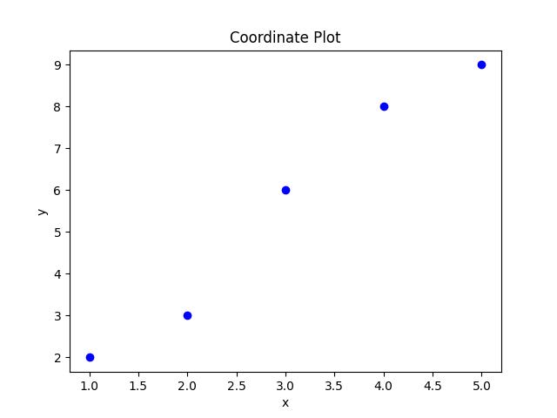
Solve a simple problem using method of least squares
$$x$$ | 1 | 2 | 3 | 4 | 5
$$y$$ | 3 | 5 | 7 | 9 | 11

Slide 34

Solve a simple problem using method of least squares
$$x$$ | 1 | 2 | 3 | 4 | 5
$$y$$ | 3 | 5 | 7 | 9 | 11
Equation of the straight line : $y$ = $ax+b$ $−−−−−(1)$

Slide 35

Solve a simple problem using method of least squares
$$x$$ | 1 | 2 | 3 | 4 | 5
$$y$$ | 3 | 5 | 7 | 9 | 11
Equation of the straight line : $y$ = $ax+b$ $−−−−−(1)$
The normal equations are,
$\sum{y}$ = $a\sum{x}$ + $nb$ $−−−−−(2)$
$\sum{xy }$= $a$ $\sum{x^{2}}$ + $b$∑𝑥 $−−−−−(3)$

Slide 36
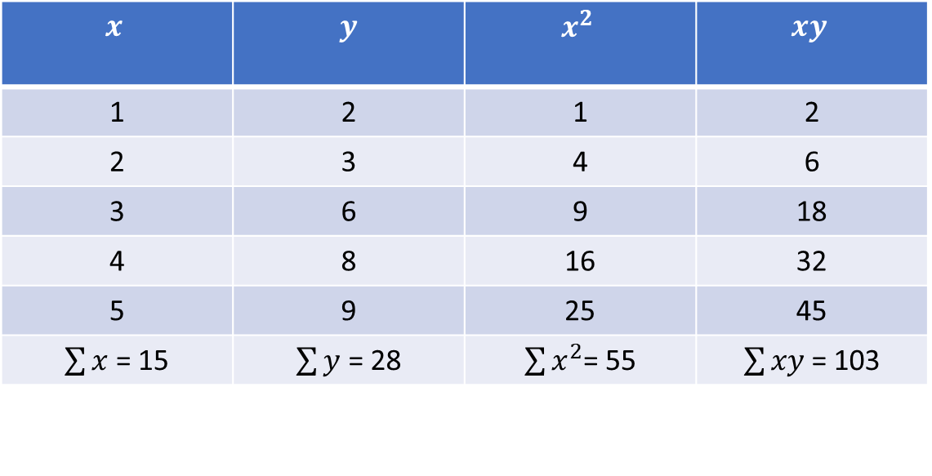
Solve a simple problem using method of least squares
$$x$$ | 1 | 2 | 3 | 4 | 5
$$y$$ | 3 | 5 | 7 | 9 | 11
Equation of the straight line : $y$ = $ax+b$ $−−−−−(1)$
The normal equations are,
$\sum{y}$ = $a\sum{x}$ + $nb$ $−−−−−(2)$
$\sum{xy }$= $a$ $\sum{x^{2}}$ + $b$∑𝑥 $−−−−−(3)$
$$x$$ | $$y$$ | $$x^{2}$$ | $$xy$$
1 | 2 | 1 | 2
2 | 3 | 4 | 6
3 | 6 | 9 | 18
4 | 8 | 16 | 32
5 | 9 | 25 | 45
$\sum{x}$ = 15 | $\sum{y}$ = 28 | $\sum{x^{2}}$= 55 | $\sum{xy }$= 103

Slide 37




$$15a+5b=28−−−−−(4)$$
$$55a+15b=103−−−−−(5)$$
Solve the equations to find a and b
$$a=1.9, b=−0.1$$
Substitute the values of a and b
$y$ = 1.9$x−0.1$

Slide 38
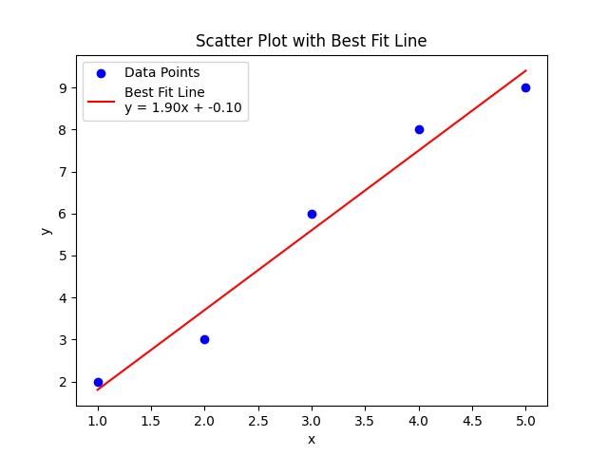
$$15a+5b=28−−−−−(4)$$
$$55a+15b=103−−−−−(5)$$
Solve the equations to find a and b
$$a=1.9, b=−0.1$$
Substitute the values of a and b
$y$ = 1.9$x−0.1$

Slide 39
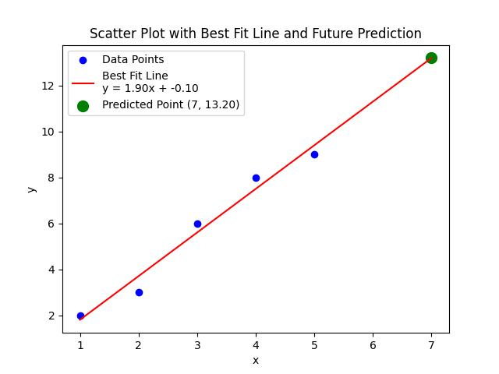


$$15a+5b=28−−−−−(4)$$
$$55a+15b=103−−−−−(5)$$
Solve the equations to find a and b
$$a=1.9, b=−0.1$$
Substitute the values of a and b
$y$ = 1.9$x−0.1$
Now we can find for new values of x
Let x = 7
$$y=1.9 ×7 −0.1$$
$$y=13.2$$

Slide 40


Slide 41
Maths! Maths! Maths!

Slide 42
Maths! Maths! Maths!
I don’t like it

Slide 43
Maths! Maths! Maths!
I don’t like it
I avoid

Slide 44
Maths! Maths! Maths!
I don’t like it
I avoid
But Maths likes me

Slide 45
Maths! Maths! Maths!
I don’t like it
I avoid
But Maths likes me
I can’t avoid

Slide 46
Thank You

